Slide 1
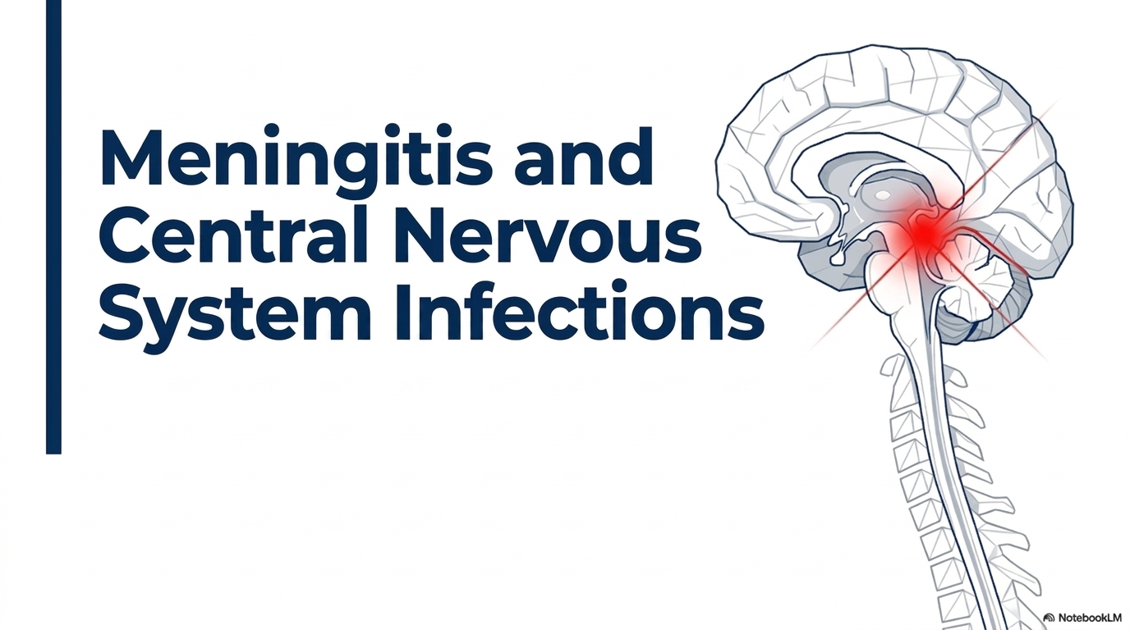
Presenters: Dr. Godard Martin.
Dr. Petro Shio.
Supervisor; Prof. Matuja.

Slide 2
OUTLINE.
Introduction
Epidermiology
Classification of meningitis
Pathophysiology
Clinical presentation
Investigation and treatment
Other CNS infections
References

Slide 3
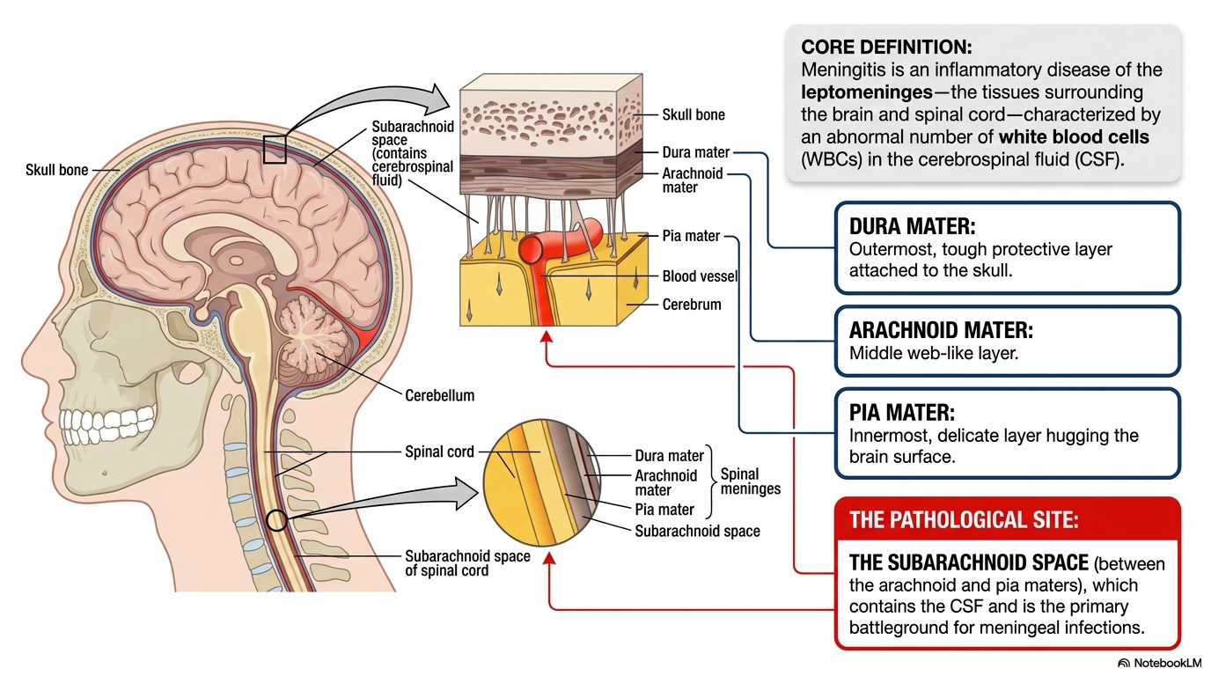
MENINGITIS

Slide 4
Epidemiology.
Despite significant advances in prevention and treatment strategies, meningitis continues to pose a substantial global health challenge.
Globally, the age-standardized incidence rate stands at 31.65 per 100,000 with a corresponding mortality rate of 2.95 per 100,000.
S. pneumoniae remains the most common etiology globally, accounting for approximately 25% to 50% of cases.
Tang C, Han R et al. Comprehensive analysis of the Global Burden and epidemiological trends of meningitis from 1990 to 2021

Slide 5
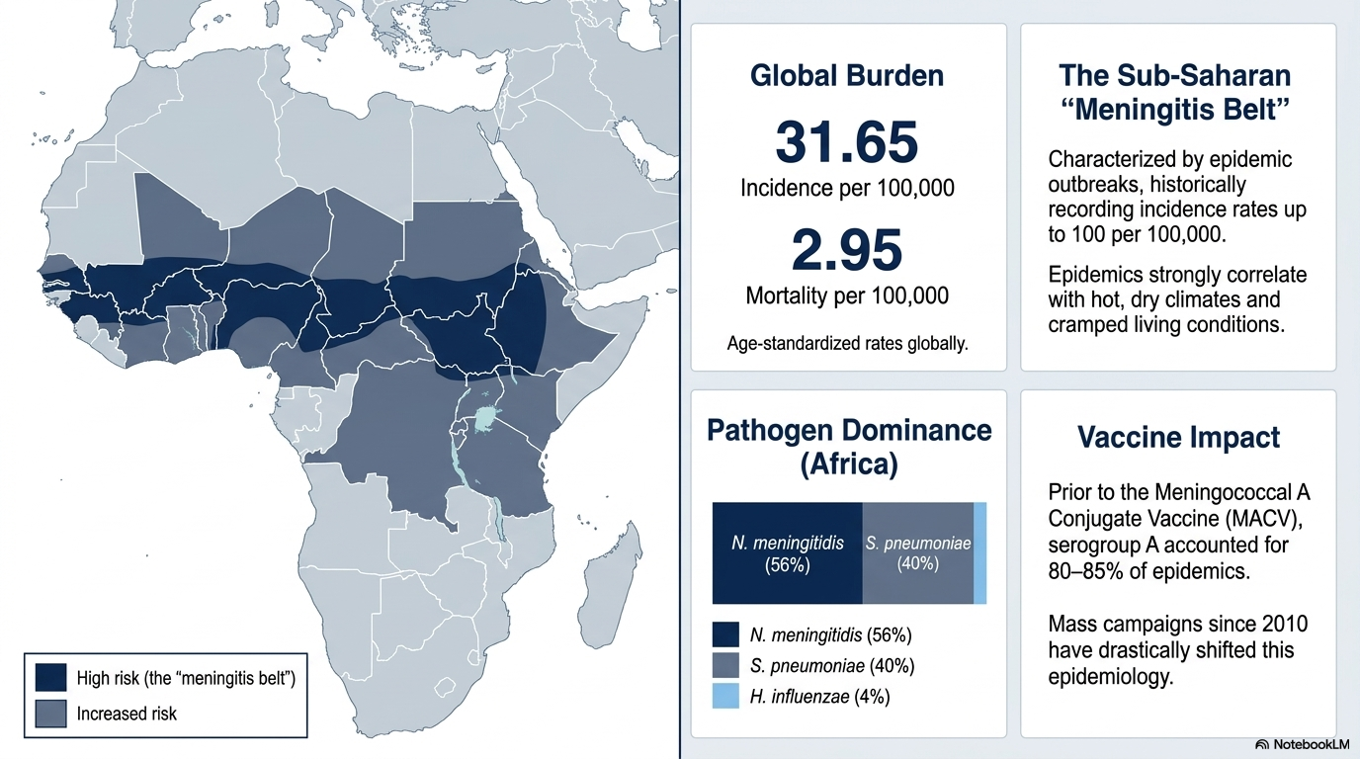
Epidemiology
Tang C, Han R, Yang J, Wu N, He D. Comprehensive analysis of the Global Burden and epidemiological trends of meningitis from 1990 to 2021
Notes:
As of April 2021, 24 of the 26 countries in the meningitis belt have conducted mass preventive campaigns targeting 1–29-year-olds (nationwide or in high-risk areas), and half of them have introduced this vaccine into their national routine immunization schedules. Among vaccinated populations, incidence of serogroup A meningitis has declined by more than 99% - no serogroup A case has been confirmed since 2017.
The African meningitis belt is a region in sub-Saharan Africa where the rate of incidence of meningitis is very high. It extends from Senegal to Ethiopia, and the primary cause of meningitis in the belt is Neisseria meningitidis.

Slide 6
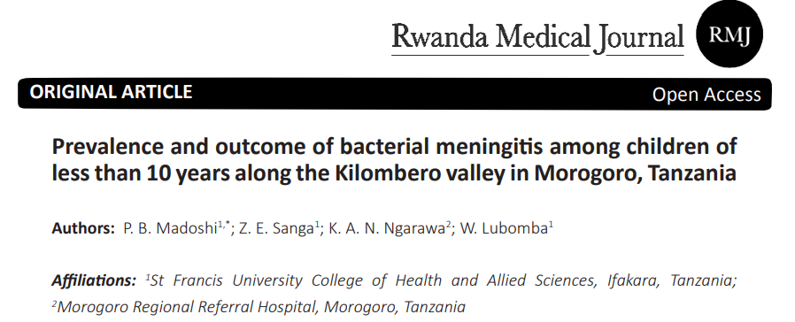
Status in Tanzania
P. B. Madoshi; Z. E. Sanga; K. A. N. Ngarawa et al. Prevalence and outcome of bacterial meningitis among children of less than 10 years along the Kilombero valley in Morogoro, Tanzania. Rwanda Medical Journal, Vol. 79, no. 1, p. 50-56, 2022

Slide 7
The analysis of the patient biodata showed that 8.3% of the 857 children had meningitis, with a case fatality rate of 11.3% in children less than 10 years old.
Generally, the clinical presentations of bacterial meningitis are not specific, which might not help establish an early diagnosis in infected patients; meanwhile, the commonest bacteria that cause the disease are Gram-negative.
Escherichia coli, Klebsiella pneumoniae, Haemophilus influenzae and Neisseria meningitides were mostly isolated from the CSF samples at the hospital.
Notes:
Bacterial Isolation Frequency (n) (%)
Klebsiella pneumonia 11 15.5
Neisseria meningitis 7 9.9
Escherichia coli 29 40.8
Haemophilus influenza 9 12.7
None specific growth 5 7.0
No bacterial growth 10 14.1

Slide 8
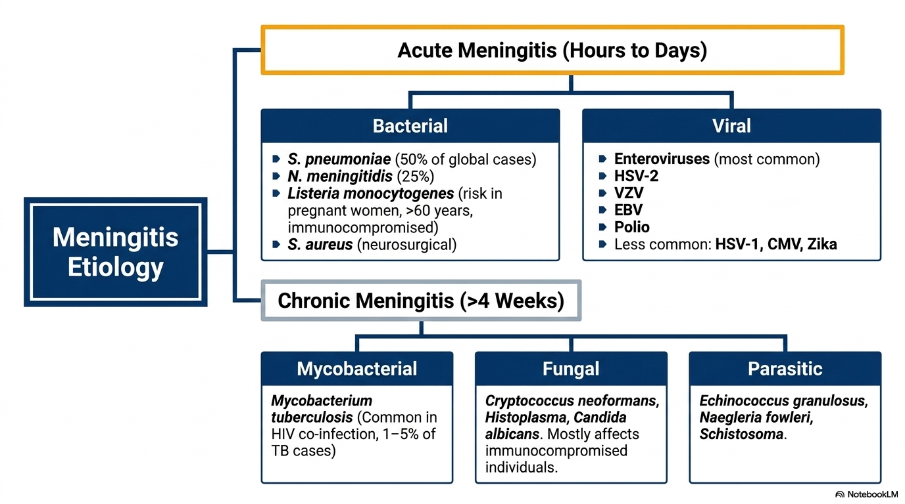
Classification of Meningitis
WHO guidelines on meningitis diagnosis, treatment and care, StatPearls - NCBI Bookshelf, and Harrison's Principles of Internal Medicine.

Slide 9
Bacteria meningitis.
Bacterial meningitis may occur through haematogenous spread or direct spread from an adjacent focus of infection in the ear(otitis), skull fracture or sinus(sinusitis) can be causative.
Epidemics of meningococcal meningitis occur particularly in cramped living conditions or where the climate is hot and dry

Slide 10
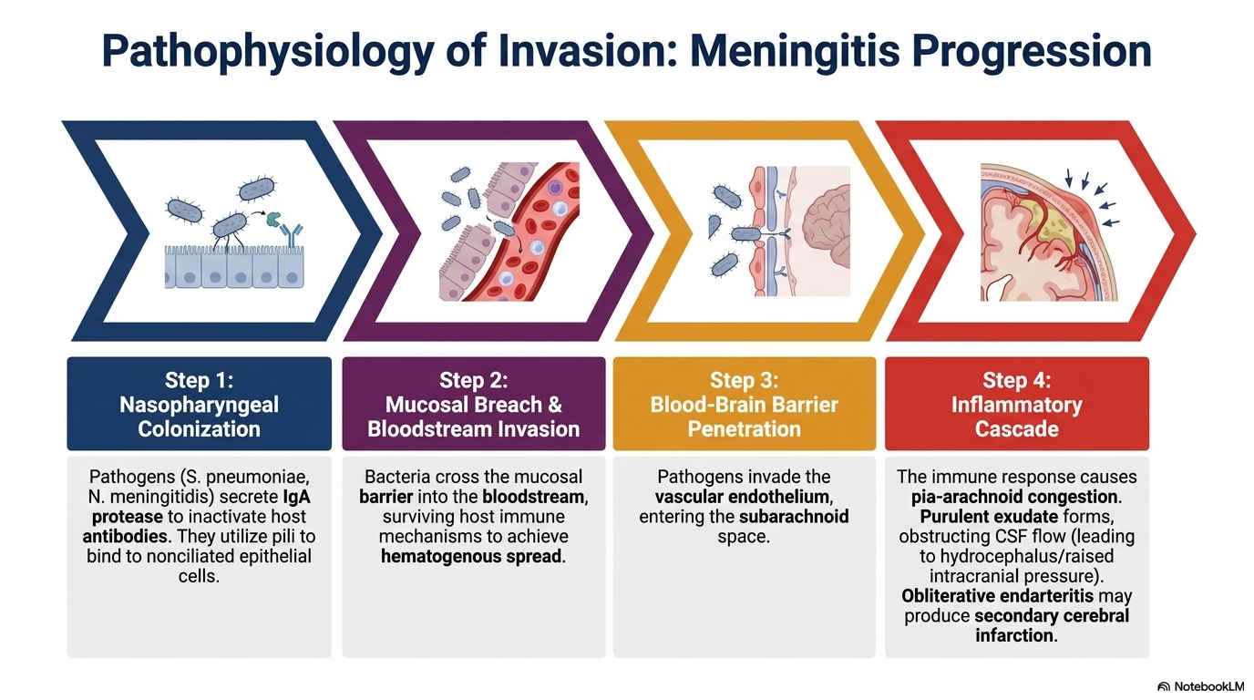

Slide 11
Clinical presentation
Classic clinical triad of meningitis is fever, altered mental status, and nuchal rigidity (“stiff neck”) seen in about 44% of patients.
Other common features include;
    Convulsions.
    Headache
    Nausea and vomiting.
    Photophobia.
    Rashes.

Slide 12
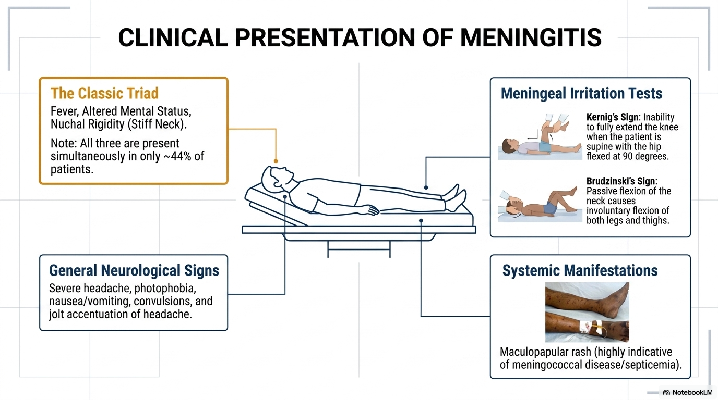

Slide 13

Investigations.
Lab evaluation,
  Lumber puncture for CSF analysis
  CBC
  Blood culture
  Serum electrolytes
  RBG
  RFT

Slide 14
Lumber puncture
Indications for urgent diagnostic LP
Suspected infectious meningitis
Suspected subarachnoid hemorrhage with neg CT scan.
Caution should be used in patients with:
possible raised intracranial pressure.
suspected spinal epidural abscess or skin/soft tissue infection overlying the LP site
Thrombocytopenia or other bleeding diathesis.

Slide 15
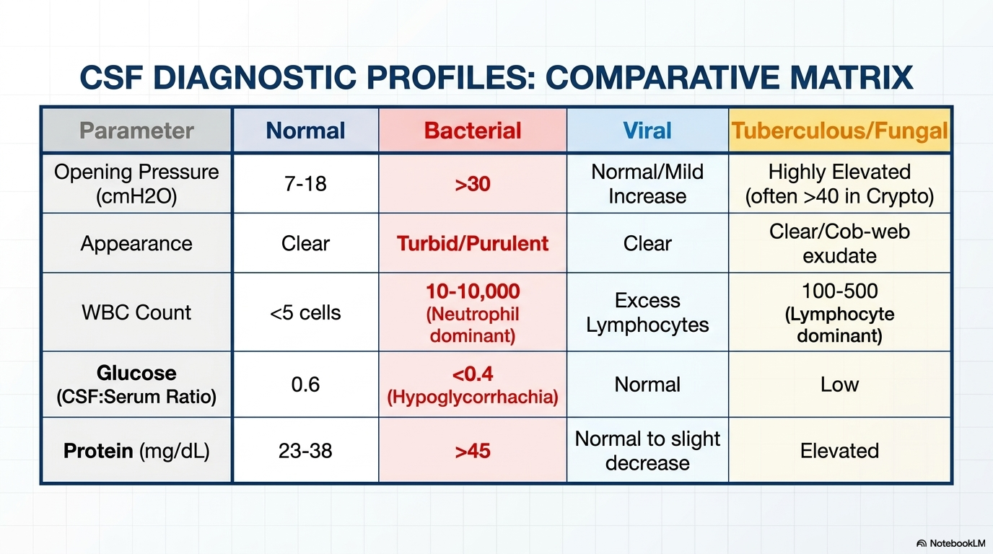

Slide 16
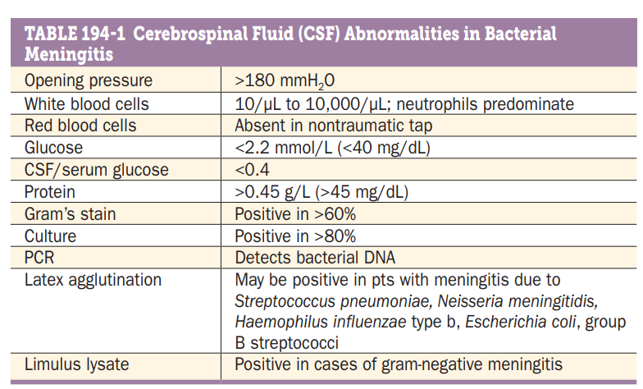
Harrison's Principles of Internal Medicine 21 ed.

Slide 17
Management
The choice of antibiotics is a three stage process:
    An initial empirical decision based on clinical suspicion,
    Review following microscopy results, and
    Review again when culture or PCR results are available.

Slide 18
Management of Meningitis - STG
I. Empirical treatment
    Ceftriaxone 2g IV 12hourly for 10–14days OR
Alternatively :
    :ampicillin (IV) 2g 6hourly for 10–14days Added if you suspect listeria OR
    : cefotaxime (IV) 2g 6-8hourly for 10–14days
May also depend on national surveillance results of the population sensitivity

Slide 19
TREATMENT
II. Where the organism is known:
Meningococcal meningitis; benzathine penicillin(IV/IM) maximum dose of 24MU/day for 10- 14 days, give 4 million units 4 hourly IV in adults AND: chloramphenicol maximum dose of 4 g/day give in divided doses at 8 hourly intervals for 10-14 days.
Haemophilus influenza meningitis: chloramphenicol (IV) 1g 6hourly for 7–10days. OR D: ceftriaxone+Sulbactam (IV) 1.5g 12hourly for 14days
Pneumococcal meningitis A: benzyl penicillin (IV) 5MU 6hourly for 14days OR D: ceftriaxone + Salbactam (FDC) (IV) 1.5mg 12hourly for 14days
Notes:
benzathine penicillin(IV/IM) 300,000U/kg/day with a
chloramphenicol (IV) 50 to 100mg/kg/day with a

Slide 20
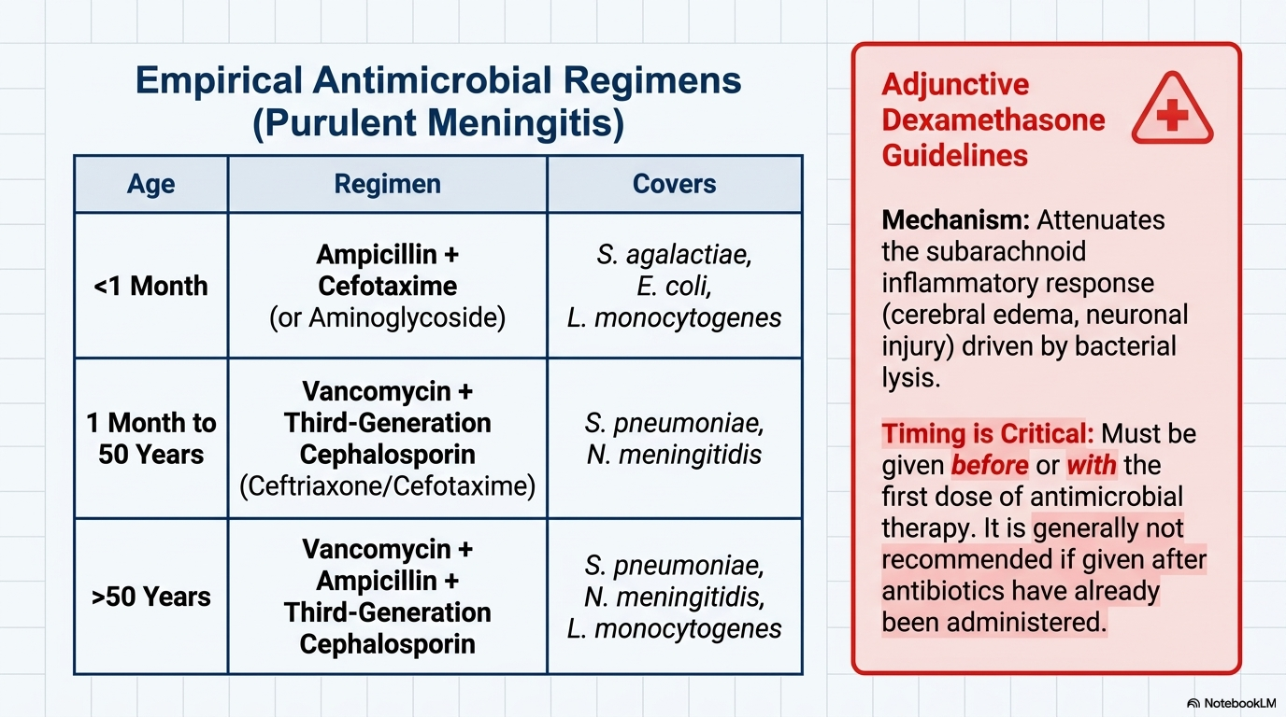
Infectious Disease Society of America (IDSA) recommendation presumptive treatment of Meningitis guidelines 2025

Slide 21
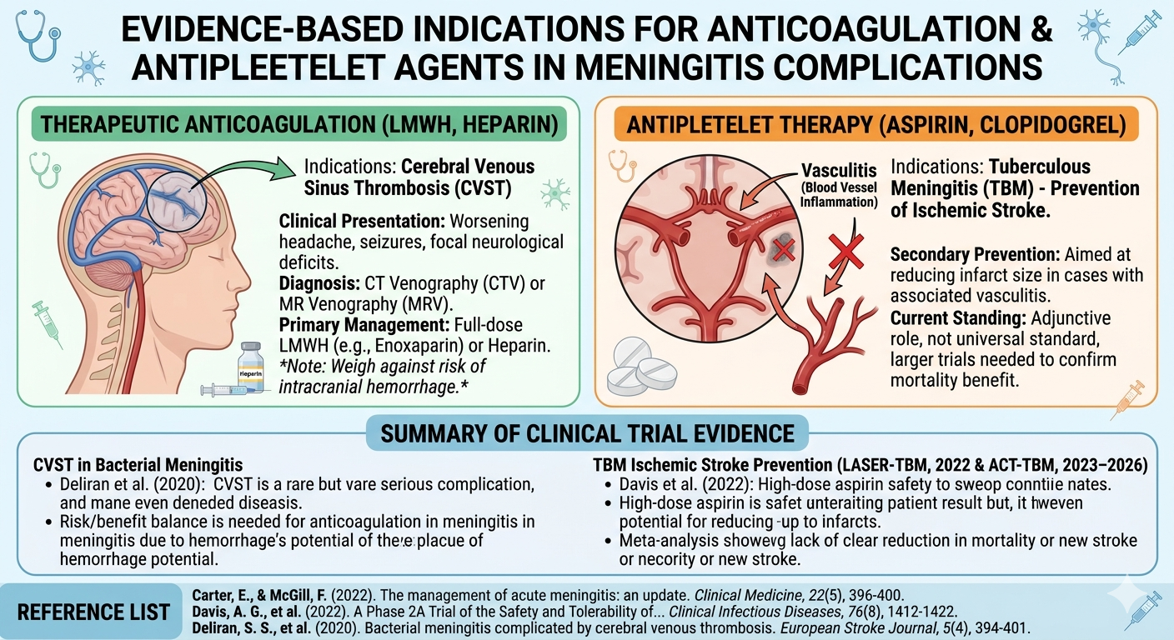

Slide 22
Viral meningitis.
Viral meningitis is an inflammation and infection of the meninges of the brain and spinal cord by a virus.
A variety of viruses can cause this inflammation of the meninges.

Slide 23
Pathophysiology.
The viruses are able to cross the blood-brain barrier by causing infection in leukocytes, which act as carriers to the virus, that are migrating into the brain for protective purposes.
Once the virus has crossed the barrier through it’s leukocyte carrier, it is able to invade the vascular endothelium because it is considered hematogenous.
This infection of the vascular endothelium is what leads to the initial inflammation of meninges in the subarachnoid space of the brain, causing an inflammatory response, which leads to the migration of inflammatory mediators and antibodies to the area of inflammation.

Slide 24
Investigation and treatment of viral meningitis.
The CSF usually contains an excess of lymphocytes but glucose and protein levels are commonly normal. It is extremely important to verify that the patient has not received antibiotics (for whatever cause) prior to the lumbar puncture.
There is no specific treatment and the condition is usually benign and self-limiting. The patient should be treated symptomatically in a quiet environment.

Slide 25
Tuberculous meningitis.
Meninges Infection due Mycobacterium tuberculosis.
One of the extra pulmonary TB manifestation developing in 1-5% of TB cases.
Commonly encountered in HIV infected individuals(among those with TB and HIV coinfection have five-fold increase likelihood of having TB CNS involvement).
Other forms of CNS TB includes tuberculoma and spinal arachnoiditis.
Agrawal DK. Epidemiology, Pathogenesis, Clinical Manifestations, and Management Strategies of Tuberculous Meningitis. Arch Intern Med Res. 2025;8(1

Slide 26
Pathogenesis.
Bacillaemia that follows primary infection or late reactivation TB, scattered tuberculous foci (tubercles) are established in the brain, meninges, or adjacent cranial bone.
The spillage of tubercular bacilli and tubercular protein into the subarachnoid space produces an intense hypersensitivity reaction, giving rise to inflammatory changes that are most marked at the base of the brain.
Three main features; Thick gelatinous exudate, tuberculous vasculitis and Hydrocephalus.

Slide 27
Clinical presentation;
Typical presentations.
  Most of the presentation resemble bacterial meningitides, the distinguishing features includes, subacute presentation, focal neurological deficits(tuberculoma) about 39% and presence of cranial nerve palsy 33.3%.
Atypical presentation.
  progressively acute, rapidly progressive meningitic syndrome suggesting pyogenic meningitis, or with slowly progressive dementia over months characterized by personality change, social withdrawal, loss of libido, and memory deficits.
Agrawal DK. Epidemiology, Pathogenesis, Clinical Manifestations, and Management Strategies of Tuberculous Meningitis. Arch Intern Med Res. 2025;8(1
Notes:
Bacterial meningitis typically presents within one week

Slide 28
Investigation;
CSF analysis –high opening pressure
CSF AFB/Gene Xpert
CSF Mycobacterial culture.
CSF- ADA
Notes:
However elevated CSF ADA may also be observed in setting of bacterial infection.

Slide 29
CSF analysis findings.
Elevated CSF opening pressure(180 -300mmH2O).
Lymphocytic pleiocytosis.
Elevated protein concentration
Low glucose concentration.
CSF WBC is between 100 -500 cells per microliters with lymphocytes predominancy.
AFB for Dx is 30% -60%.

Slide 30
Imaging modality.
Radiographic modalities for evaluation of patients with suspected CNS TB include brain CT or brain MRI. Brain MRI is superior to CT in defining lesions of the basal ganglia, midbrain, and brainstem.
In patients with tuberculous meningitis, classical neuroimaging findings include hydrocephalus, basilar exudates, periventricular infarcts, and cerebral parenchymal tuberculomas

Slide 31
Management.
2 RHZE/ 10RH.
IV Dexamethasone 0.3 to 0.4mg/kg/day for 6 to 8 weeks then tapered off afterwards
VP shunt for the patient with hydrocephalus.

Slide 32
CRYPTOCOCCAL MENINGITIS.
Cryptococcus neoformans is the most common cause of meningitis in AIDS patients and people with low immunity (immunocompromised)
Found in soil contaminated with bird droppings, decaying wood and vegetation
Transmission is by inhalation of airborne encapsulated yeast from soil contaminated with pigeon droppings.

Slide 33
Cryptococcal meningitis
The incidence of cryptococcal meningitis is 152,000 cases per year with annul deaths of 112,000 accounting for 19% of all AIDS – related mortality
In sub-Saharan Africa there are approximately 82,000 cases annually with 71,000 cryptococcus related death representing 63% of the global cryptococcal related deaths
A study done by Minja et al in Dar es salaam in 3 public regional hospitals from 2019 to 2022 involving 405 PLHIV, Showed a prevalence of 11.9 % of CM and mortality rate of 8.9%

Slide 34
Cryptococcal meningitis
Signs and symptoms
Headache, fever, intolerance to light and sound,
• Neck stiffness, vomiting, seizures, impaired vision
• In advanced stages it may present with Altered mental status that may progress to coma

Slide 35
Investigations of Cryptococcal meningitis
LP for CSF analysis.
    CrgAg test.
    Gram stain
    Culture
    Indian ink.
LP for opening pressure. (more than 40cmH20)
Serum CrAg test.
Notes:
Brain imaging?? MRI - may demonstrate cryptococcomas

Slide 36
Management – STG.
Phase 1: Induction phase ; Amphotericin B 0.7mg/kg/day IV + 5 Flucytosine 100mg/kg/day administered orally for 14 days •
Phase 2: Consolidation phase ; Fluconazole 400mg/ day for 8 weeks or until CSF is sterile.
Phase 3: Suppressive phase; Give patient maintenance therapy with Fluconazole 200mg per day.
In absence of Amphotericin B and Flucytosine, alternative therapy should be:
Phase 1: Induction phase ; Fluconazole 1200mg IV/ORAL once daily for 14 days
Phase 2: Consolidation phase • Fluconazole 400mg/ day for 8 weeks or until CSF is sterile.
Phase 3: Suppressive phase ; Give patient maintenance therapy with Fluconazole 200mg per day(1).
Notes:
Discontinue maintenance treatment if CD4 ≥100 with undetectable

Slide 37
WHO Cryptococcal Meningitis in HIV Guideline
As of 2025, the current World Health Organization (WHO) guidelines for managing cryptococcal meningitis in people living with HIV prioritize a simplified, "single high-dose" regimen.
This updated approach aims to reduce hospital stays and minimize the toxic side effects associated with older treatment protocols.
The Preferred Induction regimen , the WHO strongly recommends a simplified induction phase for patients with advanced HIV disease

Slide 38
Recommendations
One week of Amphotericin B deoxycholate(1mg/kg/day) and flucytosine based therapy(1.2g/day) followed by a week of 1.2g of Fluconazole for induction phase.
Alternatively
Two weeks of fluconazole (1200 mg daily for adults, 12 mg/kg/day for children and adolescents) + flucytosine (100 mg/kg/day, divided into four doses per day)
Two weeks of amphotericin B deoxycholate (1.0 mg/kg/day) + fluconazole (1200 mg daily for adults,
NB: Pediatric dose of fluconazole 12mg/kg/day Max 800mg

Slide 39
OTHER CNS INFECTIONS.

Slide 40
OTHER CNS INFECTIONS
CNS infections can infect various parts of the brain including the meninges and the brain parenchyma
Brain parenchyma infections varies on their pathophysiological mechanism and etiology agents.
Some of the infections includes encephalitis, neurocysticercosis, progressive multifocal leukoencephalopathy (PML), Brain abscess, toxoplasmosis

Slide 41
1. ENCEPHALITIS
Inflammation of the brain parenchyma can caused by either an infection, usually with a virus or from a primary autoimmune process.
The most common causes of sporadic viral encephalitis in immunocompetent adults are herpesviruses 1.
Other include causes of encephalitis include VZV, CMV and Rabies
Epidemics of viral encephalitis are usually caused by arboviruses (WNV, EEEV, JEV).

Slide 42
Pathogenesis of viral encephalitis.
Damage of the brain parenchyma is caused by direct cytopathic effect and immune mediated damage causing an inflammatory response causing neuronal dysfunction
The distribution of lesions varies with the type of virus. For example, in herpes simplex encephalitis, the temporal lobes are usually primarily affected, whereas cytomegalovirus can involve the areas adjacent to the ventricles (ventriculitis).
Inclusion bodies may be present in the neurons and glial cells and there is an infiltration of polymorphonuclear cells in the perivascular space.

Slide 43
Clinical features.
Signs of focal neurological deficits(aphasia, hemiparesis, involuntary movements and cranial nerve deficits)
Other features includes, headache, fever, behavioural changes, hallucinations and seizures.
Rabies have distinct characteristics; anxiety, confusion, and agitation. As the disease progresses, the person may experience delirium, hallucinations, hydrophobia and insomnia

Slide 44
Investigations.
CSF PCR tests allow for rapid and reliable diagnosis of HSV, EBV, CMV, HHV-6, and enteroviruses.
virus-specific IgM antibodies. Demonstration of WNV IgM antibodies in the CSF is diagnostic of WNV encephalitis.
IgG and IgM titers may be more sensitive than PCR for VZV
Rabies can be diagnosed rapid immunofluorescent techniques (direct fluorescent antibody ) can detect antigen in corneal impression smears or skin biopsies.
Notes:
MRI is the neuroimaging procedure of choice and demonstrates areas of increased T2 signal. Bitemporal and orbitofrontal areas of increased signal are seen in HSV encephalitis, but are not diagnostic

Slide 45
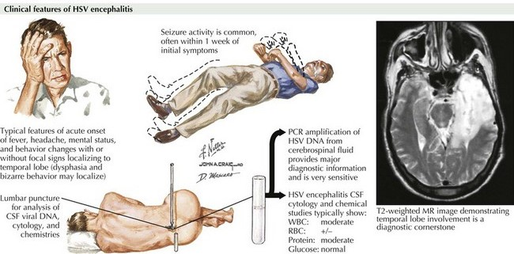

Slide 46
Treatment.
IV/PO Acyclovir 10mg/kg every 8hrs for 14 days is the treatment of choice for HSV-1, HSV-2, and VZV encephalitis.
CMV encephalitis A combination of Ganciclovir 5 mg/kg IV every 12 hours and Foscarnet 60 mg/kg IV every 8 hours or 90 mg/kg IV every 12 hours for 21 days
There is no antiviral therapy for arboviral or rabies encephalitis.

Slide 47
2. NEUROCYSTICERCOSIS.
Human cysticercosis is acquired by ingesting T. solium tapeworm ova, from either contaminated fingers or food.
Common locations are the subcutaneous tissue, skeletal muscles and brain (neurocysticercosis).

Slide 48
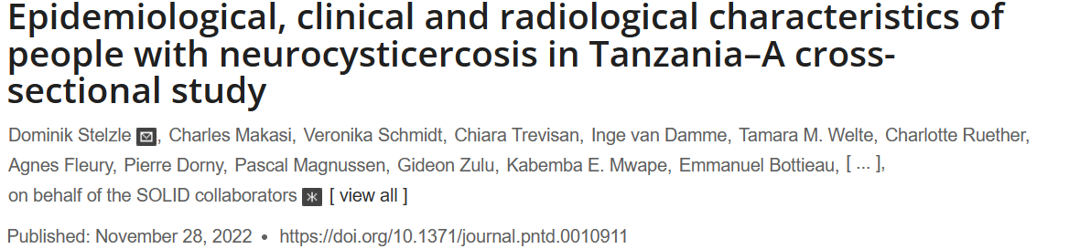
In all three (Ifisi, Tukuyu and Vwawa) district hospitals, more than 30% of all people with epileptic seizures (PWE) had NCC lesions in their brain (38% in Vwawa, 32% in Tukuyu and 31% in Ifisi). Most PWE with NCC had multiple lesions and mostly parenchymal lesions (at least 85%)
Notes:
Neurocysticercosis (NCC) is common among people with epilepsy in low-resource settings

Slide 49
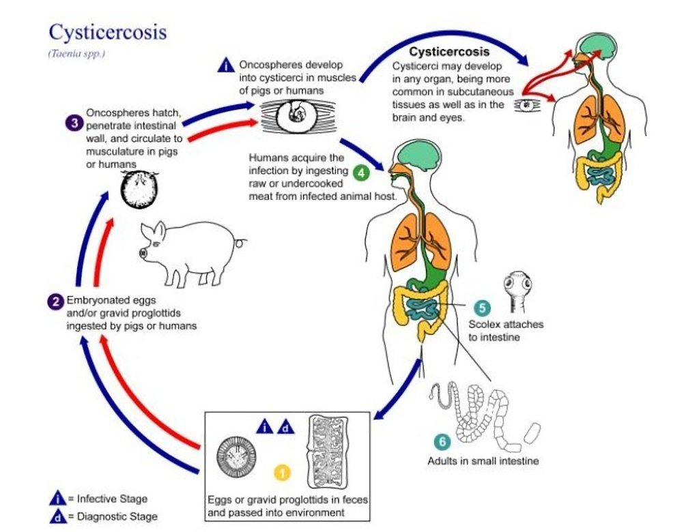

Slide 50
Clinical features.
Neurologic manifestations are most common and include
  seizures (due to inflammation surrounding cysticerci in the brain)
  hydrocephalus (from obstruction of CSF flow by cysticerci and accompanying inflammation or arachnoiditis.
  increased intracranial pressure (e.g., headache, nausea, vomiting, changes in vision).

Slide 51
Investigation.
Contrast head CT scan; ring enhancing lesions, calcified lesions
Contrast brain MRI - viable cystic lesions with scolices
Notes:
Note : Fundoscopic examination is mandatory for all patients before initiation of anthelminthic therapy-

Slide 52
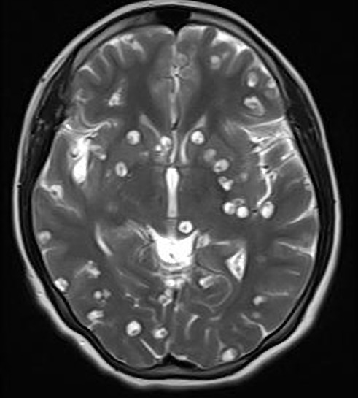

MRI findings for Neurocysticercosis
Disseminated neurocysticercosis

Slide 53
Treatment.
Albendazole (15 mg/kg per day for 8–28 days) or
Praziquantel (50–100 mg/kg daily in three divided doses for 15–30 days).
A combination of albendazole and praziquantel (50 mg/kg in three divided doses per day) is more effective in pts with more than two cystic lesions.

Slide 54
3. PROGRESSIVE MULTIFOCAL LEUKOENCEPHALOPATHY (PML)
A progressive disorder due to infection with the JC virus, a human polyoma virus
It is characterized by multifocal areas of demyelination of the subcortical white matter involving the parietal and occipital lobes with characteristic cytologic alterations in astrocytes and oligodendrocytes.
Notes:
JC - John Cunningham virus.

Slide 55
Clinical presentation.
visual deficits , typically a homonymous hemianopia
mental impairement (dementia, confusion, personality change)
Focal neurological symptoms.
Seizures

Slide 56
Investigation.
MRI reveals multifocal asymmetric, coalescing white matter lesions located peri ventricularly, in the centrum semiovale, in the parietal-occipital region, and in the cerebellum- (CT scan is less sensitive.)
A positive CSF PCR for JC virus DNA in association with typical MRI lesions in the appropriate clinical setting is diagnostic of PML

Slide 57
Treatment.
No effective therapy is available.
Some pts with HIV-associated PML have shown dramatic clinical gains associated with improvement in immune status following institution of highly active antiretroviral therapy (HAART).

Slide 58
4. BRAIN ABSCESS
Brain abscess is a focal pus collection within the brain parenchyma, which can arise as a complication of a variety of infections, trauma, or surgery.
Many abscesses are common in immunocompromised individuals and the most common organisms includes;
  toxoplasma gondii, aspergillus spp, Norcadia spp, Candida spp and cryptococcus neoformans.

Slide 59
Brain Abcess Epidermiology
Populations in low-resource settings have a higher burden of brain abscess. It accounts for less than 1% of intracranial lesions in the developed world, as opposed to roughly 8% in developing countries
Although brain abscess can affect both sexes, in multiple series of both pediatric and adult patients, the male-to-female ratio of brain abscess has been demonstrated to range from 2:1 to as great as 4:1.
Throughout the first half of the 20th century, the age distribution of brain abscess was bimodal, with the highest rates being among children and adults older than 60 years.
Epidemiology, Pathogenesis, Clinical Manifestations, and Management Strategies of Meningitis. Arch Intern Med Res. 2025;8(1):48-58. doi: 10.26502/aimr.0195

Slide 60
Clinical presentation
The clinical manifestations of brain abscess typically include headache, fever, and focal neurologic deficits. However, early in the course of disease, the manifestations can be nonspecific.
symptoms
  Headache is the most common symptom of a brain abscess (69%).
  Neck stiffness – Neck stiffness occurs in 15% of patients with brain abscess.
  Altered mental status – Changes in mental status (lethargy progressing to coma) are indicative of severe cerebral edema and are a poor prognostic sign.
  Vomiting – Vomiting generally develops in association with increased intracranial pressure .

Slide 61
Clinical presentation
Fever – Fever may be seen in patients with brain abscess but is not a reliable indicator since only 45 to 53 %of patients have this sign .
Focal neurologic deficits – are observed in up to 50 % of patients and generally occur days to weeks after the onset of headache. Third and sixth cranial nerve deficits indicate raised intracranial pressure. Papilledema is a late manifestation of cerebral edema and usually takes several days to develop. This finding is observed in approximately 25%of patients.
Seizures – Seizures develop in 25% of cases and can be the first manifestation of brain abscess . Grand mal seizures are particularly common in frontal abscesses.
Notes:
specific deficits depend upon the intracranial location of the brain abscess

Slide 62
Investigations
MRI is superior to CT for demonstaring abcesses in the early stages (celebritis) and also for abscesses at the posterior fossa. Abscesses are usually hyperintense on diffusion-weighted MRI, indicating restricted diffusion, characteristic of viscous materials, such as pus.
Labs: microbiological diagnosis best determines by Gram’s stain and culture of abscess material obtained from needles aspirations.
Notes:
O

Slide 63
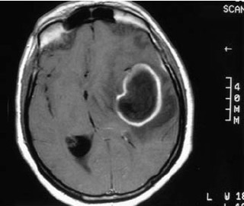
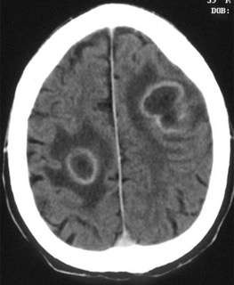
Notes:
(a) MRI scan in a 37-year-old male showing a large brain abscess located in the left temporoparietal area
(b) Contrast-enhanced computed tomography: bilateral brain abscesses with hypodense centre (central necrosis), limited by a ring-shaped, contrast-enhanced capsule, surrounded by a variable hypodense area (oedema).

Slide 64
Treatment
high-dose parenteral antibiotics and neurosurgical drainage.
Empirical therapy of community-acquired brain abscess in an immunocompetent pt typically includes a third- or fourth-generation cephalosporin (e.g., cefotaxime, ceftriaxone, or cefepime) and metronidazole.
Aspiration and drainage essential in most cases.
Medical therapy alone is reserved for pts whose abscesses are neurosurgically inaccessible and for pts with small (<2–3 cm) or nonencapsulated abscesses (cerebritis).
Notes:
Glucocorticoids should not be given routinely.
• Serial MRI or CT scans should be obtained on a monthly or twice-monthly basis to document resolution of the abscess.
All pts should receive a minimum of 6–8weeks of parenteral antibiotic therapy.
Pts should receive prophylactic anticonvulsant therapy.
In pts with penetrating head trauma or recent neurosurgical procedures, treatment should include ceftazidime to enhance coverage of Pseudomonas spp. and vancomycin for coverage of resistant staphylococci. Meropenem plus vanco- mycin also provides good coverage in this setting.

Slide 65
5. TOXOPLASMOSIS
Toxoplasmosis, an infection with a worldwide distribution, is caused by the intracellular protozoan parasite, Toxoplasma gondii.
Immunocompetent persons with primary infection are usually asymptomatic. However, in some immunocompetent individuals, T. gondii infection can present as an acute systemic infection or as ocular disease (eg, posterior uveitis).
In immunosuppressed patients, especially patients with AIDS, the parasite can reactivate and cause disease, when the CD4 count falls below 100cell/mm3.

Slide 66
Epidemiology.
In various places throughout the world, it has been shown that more than 60% of some populations have been infected with Toxoplasma.
Infection is often highest in areas of the world that have hot, humid climates and lower altitudes, because the oocysts survive better in these types of environments.
Epidemiology, Pathogenesis, Clinical Manifestations, and Management Strategies . Arch Intern Med Res. 2025;8(1):48-58.
Notes:
There are four means of acquiring toxoplasmosis in humans :
●Ingestion of infectious oocysts from the environment (usually from soil or fresh water sources contaminated with feline feces) or from contaminated fruits or vegetables
●Ingestion of tissue cysts in meat from an infected animal
●Vertical transmission from an infected mother to her fetus
●Transmission through an organ transplantation from an infected donor

Slide 67
Clinical Presentation
In immunocompetent hosts is usually asymptomatic (80–90% of cases) and self-limited and does not require therapy. In contrast, immunocompromised pts, including newborns, can develop severe infections typically involving the CNS.
General symptoms — Patients with acute toxoplasmosis typically present with constitutional symptoms, such as fever, chills, and sweats; however, these symptoms are generally mild, and the febrile episodes usually last two to three days.
Lymphadenopathy — The most common clinical manifestation of acute toxoplasmosis is bilateral, symmetrical, nontender cervical adenopathy . Approximately 20 to 30 % develop generalized lymphadenopathy.
Notes:
Headaches, myalgias, pharyngitis, hepatosplenomegaly, and/or a diffuse non-pruritic maculopapular rash may also occur.
The lymph nodes are usually smaller than 3 centimeters in size and are nonfluctuant. Unlike the fever, which lasts for a short duration, lymphadenopathy can persist for weeks.
Uncommon manifestations — On rare occasions, immunocompetent patients may present with severe disease such as pneumonitis , acute respiratory distress syndrome, myocarditis , pericarditis , polymyositis , hepatitis, posterior uveitis, or encephalitis.

Slide 68
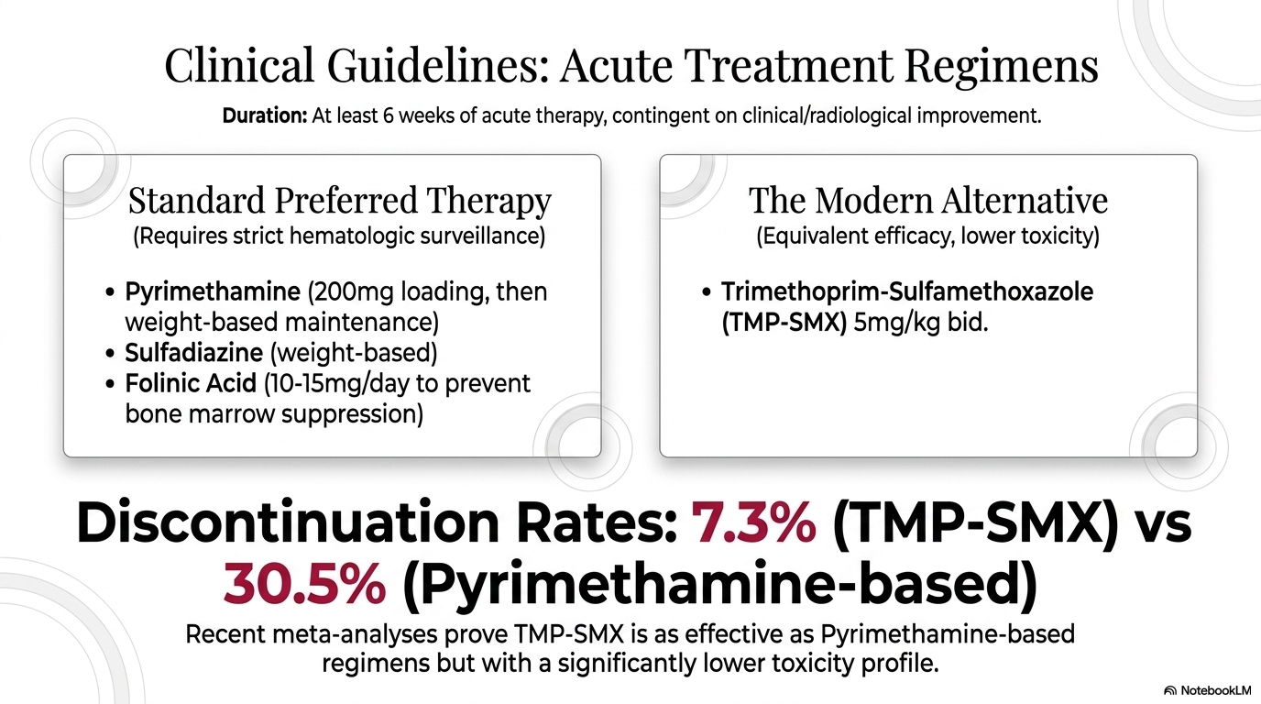
Diagnosis
Serology is the primary method of diagnosis.
  An enzyme-linked immunosorbent assay (ELISA) is most commonly used.
Molecular techniques that can detect the parasite’s DNA in the amniotic fluid can be useful in cases of possible mother-to-child (congenital) transmission.
Ocular disease is diagnosed based on the appearance of the lesions in the eye, symptoms, course of disease, and often serologic testing
Notes:
Laboratory findings — Laboratory findings are nonspecific in patients with toxoplasmosis.
Patients may have a slight lymphocytosis with or without atypical cells. If atypical lymphocytes are present, they usually account for less than 10 percent of the total leukocyte count. Hepatic transaminases may also be slightly elevated, and there may be moderate increases in the C-reactive protein.

Slide 69
References
Tanzania Standard Treatment Guideline – 2021
Tang C, Han R, Yang J, Wu N, He D. Comprehensive analysis of the Global Burden and epidemiological trends of meningitis from 1990 to 2021. Infection. 2025 Mar 3:1-7.
Harrison’s manual of medicine 20th edition
Davidison’s principles and practice of medicine 22nd edition
Barichello T, Rocha Catalão CH, Rohlwink UK, Kuip Mvd, Zaharie D, Solomons RS, van Toorn R, Tutu van Furth M, Hasbun R, Iovino F and Namale VS (2023) Bacterial meningitis in Africa. Front. Neurol. 14:822575.
https://www.who.int/news-room/fact-sheets/detail/meningitis
https://www.researchgate.net/figure/The-meningitis-belt-of-sub-Saharan-Africa-and-meningococcal-serogroup-A-conjugate-vaccine_fig1_320819976
https://www.cdc.gov/parasites/toxoplasmosis/epi.html
https://www.researchgate.net/profile/Band-Rathnayak/publication/388634634_Meningitis_A_Review_of_Pathophysiology_Diagnosis_and_Treatment_Protocols/links/67a03e6252b58d39f2671374/Meningitis-A-Review-of-Pathophysiology-Diagnosis-and-Treatment-Protocols.pdf
Oo N, Agrawal DK. Epidemiology, Pathogenesis, Clinical Manifestations, and Management Strategies of Tuberculous Meningitis. Arch Intern Med Res. 2025;8(1):48-58. doi: 10.26502/aimr.0195. Epub 2025 Feb 10. PMID: 40061519; PMCID: PMC11887623.

Slide 70
References
11. Management of acute meningitis | RCP Journals
12. Epidemiological, clinical and radiological characteristics of people with neurocysticercosis in Tanzania–A cross-sectional study | PLOS Neglected Tropical Diseases
13. Cryptococcal Meningitis Management in Tanzania With Strict S... : JAIDS Journal of Acquired Immune Deficiency Syndromes (lww.com)
14. Salazar L, Hasbun R. Cranial imaging before lumbar puncture in adults with community-acquired meningitis: clinical utility and adherence to the Infectious Diseases Society of America guidelines. Clinical infectious diseases. 2017 Jun 15;64(12):1657-62.
15. Griffiths MJ, McGill F, Solomon T. Management of acute meningitis. Clin Med (Lond). 2018 Mar;18(2):164-169. doi: 10.7861/clinmedicine.18-2-164. PMID: 29626023; PMCID: PMC6303447
16. Rajasinham, R, Meya, D.B., Boulware, D.R., et al. (2022) “The global burden of HIV- associated cryptococcal infection in adults in 2020:a modelling analysis”, The lancetInfectious Diseases, 22(12),pp. 1708 -1717
17. van de Beek D, Brouwer MC, Koedel U, Wall EC. Community-acquired bacterial meningitis. The Lancet. 2021 Sep 25;398(10306):1171-83.
18. Hall WA, Mesfin FB. Brain Abscess.
19. Wen A, Cao WF, Liu SM, Zhou YL, Xiang ZB, Hu F, Wu LF, Cai W, Leng EL. Incidence and risk factors of cranial nerve palsy in patients with tuberculous meningitis: a retrospective evaluation. Infection and Drug Resistance. 2023 Dec 31:829-41.
20. Anuradha HK, Garg RK, Sinha MK, Agarwal A, Verma R, Singh MK, Shukla R. Intracranial tuberculomas in patients with tuberculous meningitis: predictors and prognostic significance. The International journal of tuberculosis and lung disease. 2011 Feb 1;15(2):234-9.
Notes:
Cryptococcal Meningitis Management in Tanzania With Strict S... : JAIDS Journal of Acquired Immune Deficiency Syndromes (lww.com)

